Slide 1

Master of Data Science Capstone Project Glentel:
Identifying Traits Associated with High Performance Presenters:
Clara Su Manuel Maldonado Robert Pimentel Thomas Pin Mentor: Varada Kolhatkar

Slide 2
UBC Master Of Data Science
Data Science – providing quantitate measures to answer questions using data
Address the workforce gap between technical skills and practical experience
Established in 2016 – 4th Cohort
10 month accelerated program

Slide 3
Objective
Provide a quantitively measures about the traits of “high performing” employees
An employee high performance persona
Higher caliber of employee
Increase number of phone activation per employee

Slide 4
Due Diligence
Business comprehension sessions
Exploration Analysis – to understand data
Multiple features and models were tried out

Slide 5
Software
Git
Python Programming Language/Anaconda
R Programming Language
GNU Make
We will take care of the rest!
Free & Opensource

Slide 6
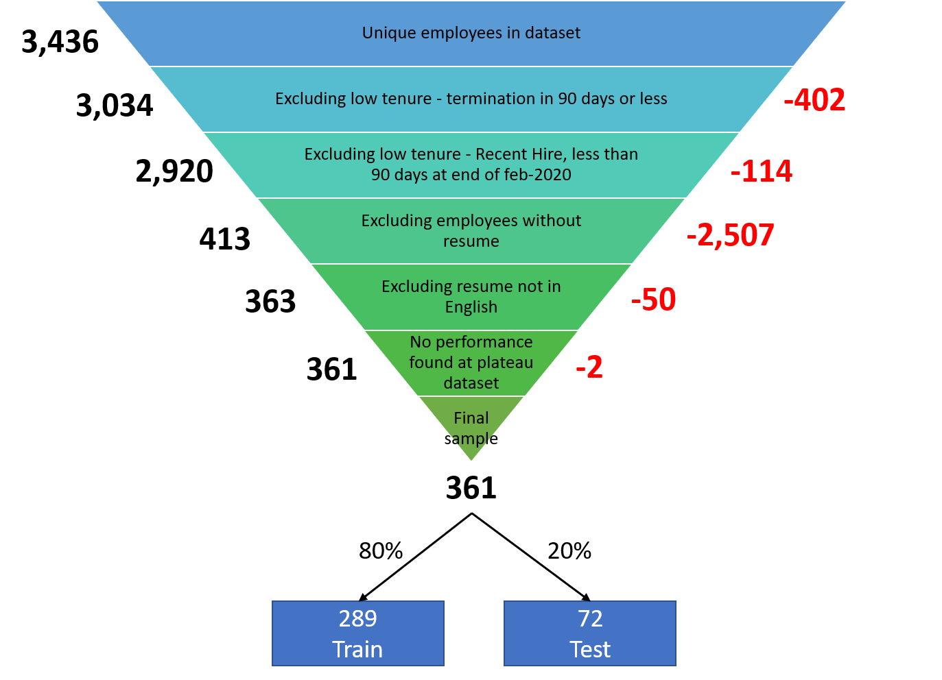
Data Sample Details
3,436 unique employees retrieved between Jan 2019 and Mar 2020
361 employees were compatible for our study
Training and Testing dataset
80% or 289 employees in the training dataset
20% or 72 employees in the testing dataset

Slide 7

Data Performance
Target
High Performance
Non-High Performance

Slide 8
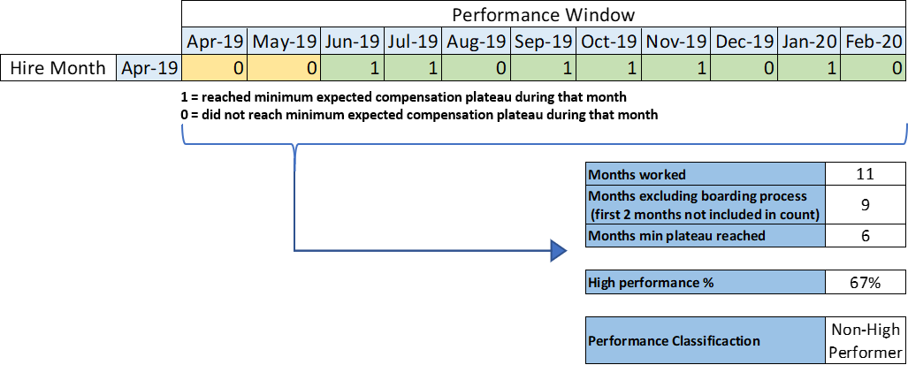
Data High Performer Definition
An employee who reaches the business expectations in 75% of the time
Business expectation is measured my monthly pay level reached
Example Employee
For the purposes of this analysis our definition was simplified high performance definition

Slide 9
Training Data

Slide 10
Initial Exploration

Slide 11
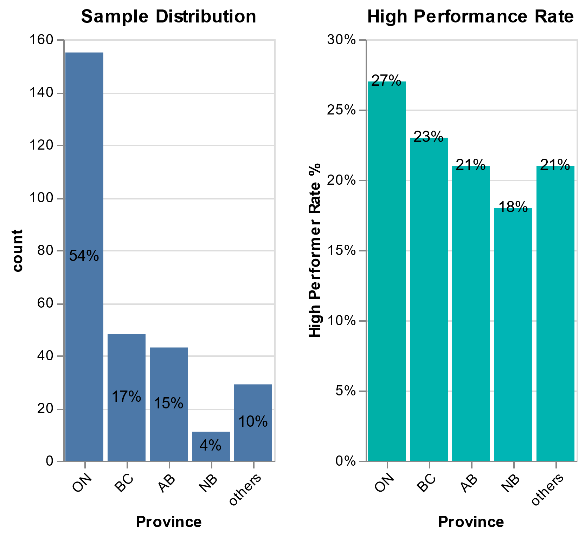
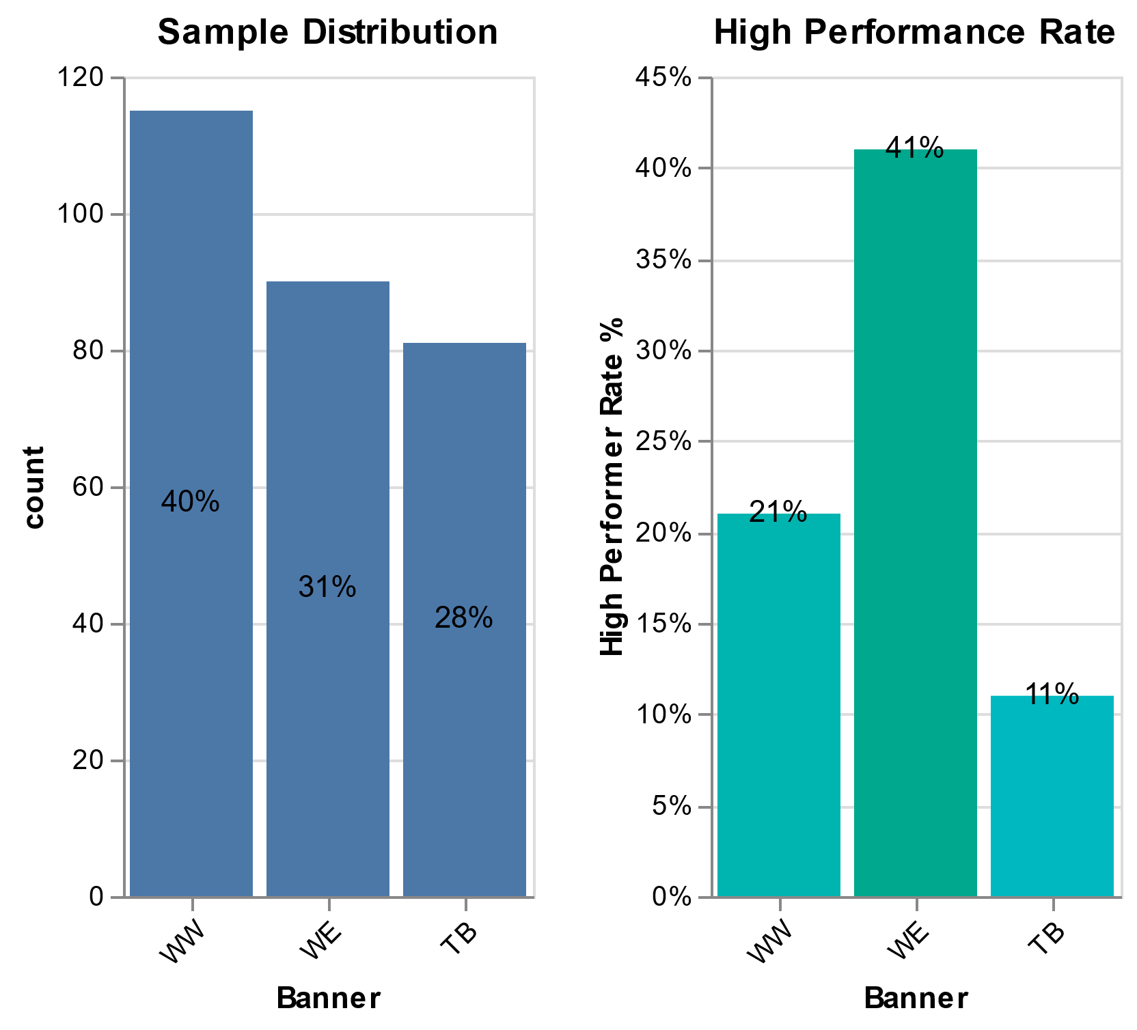
How rare are these high performers?

Slide 12
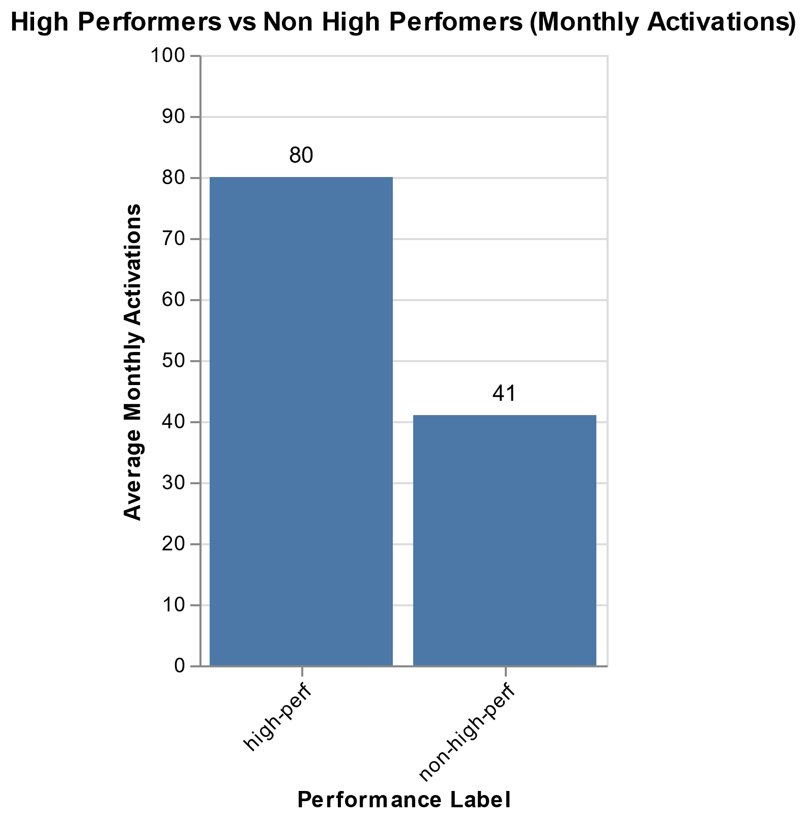
What is the difference between High performers and Non High Performers?
High performers double non-high performers in monthly activations

Slide 13
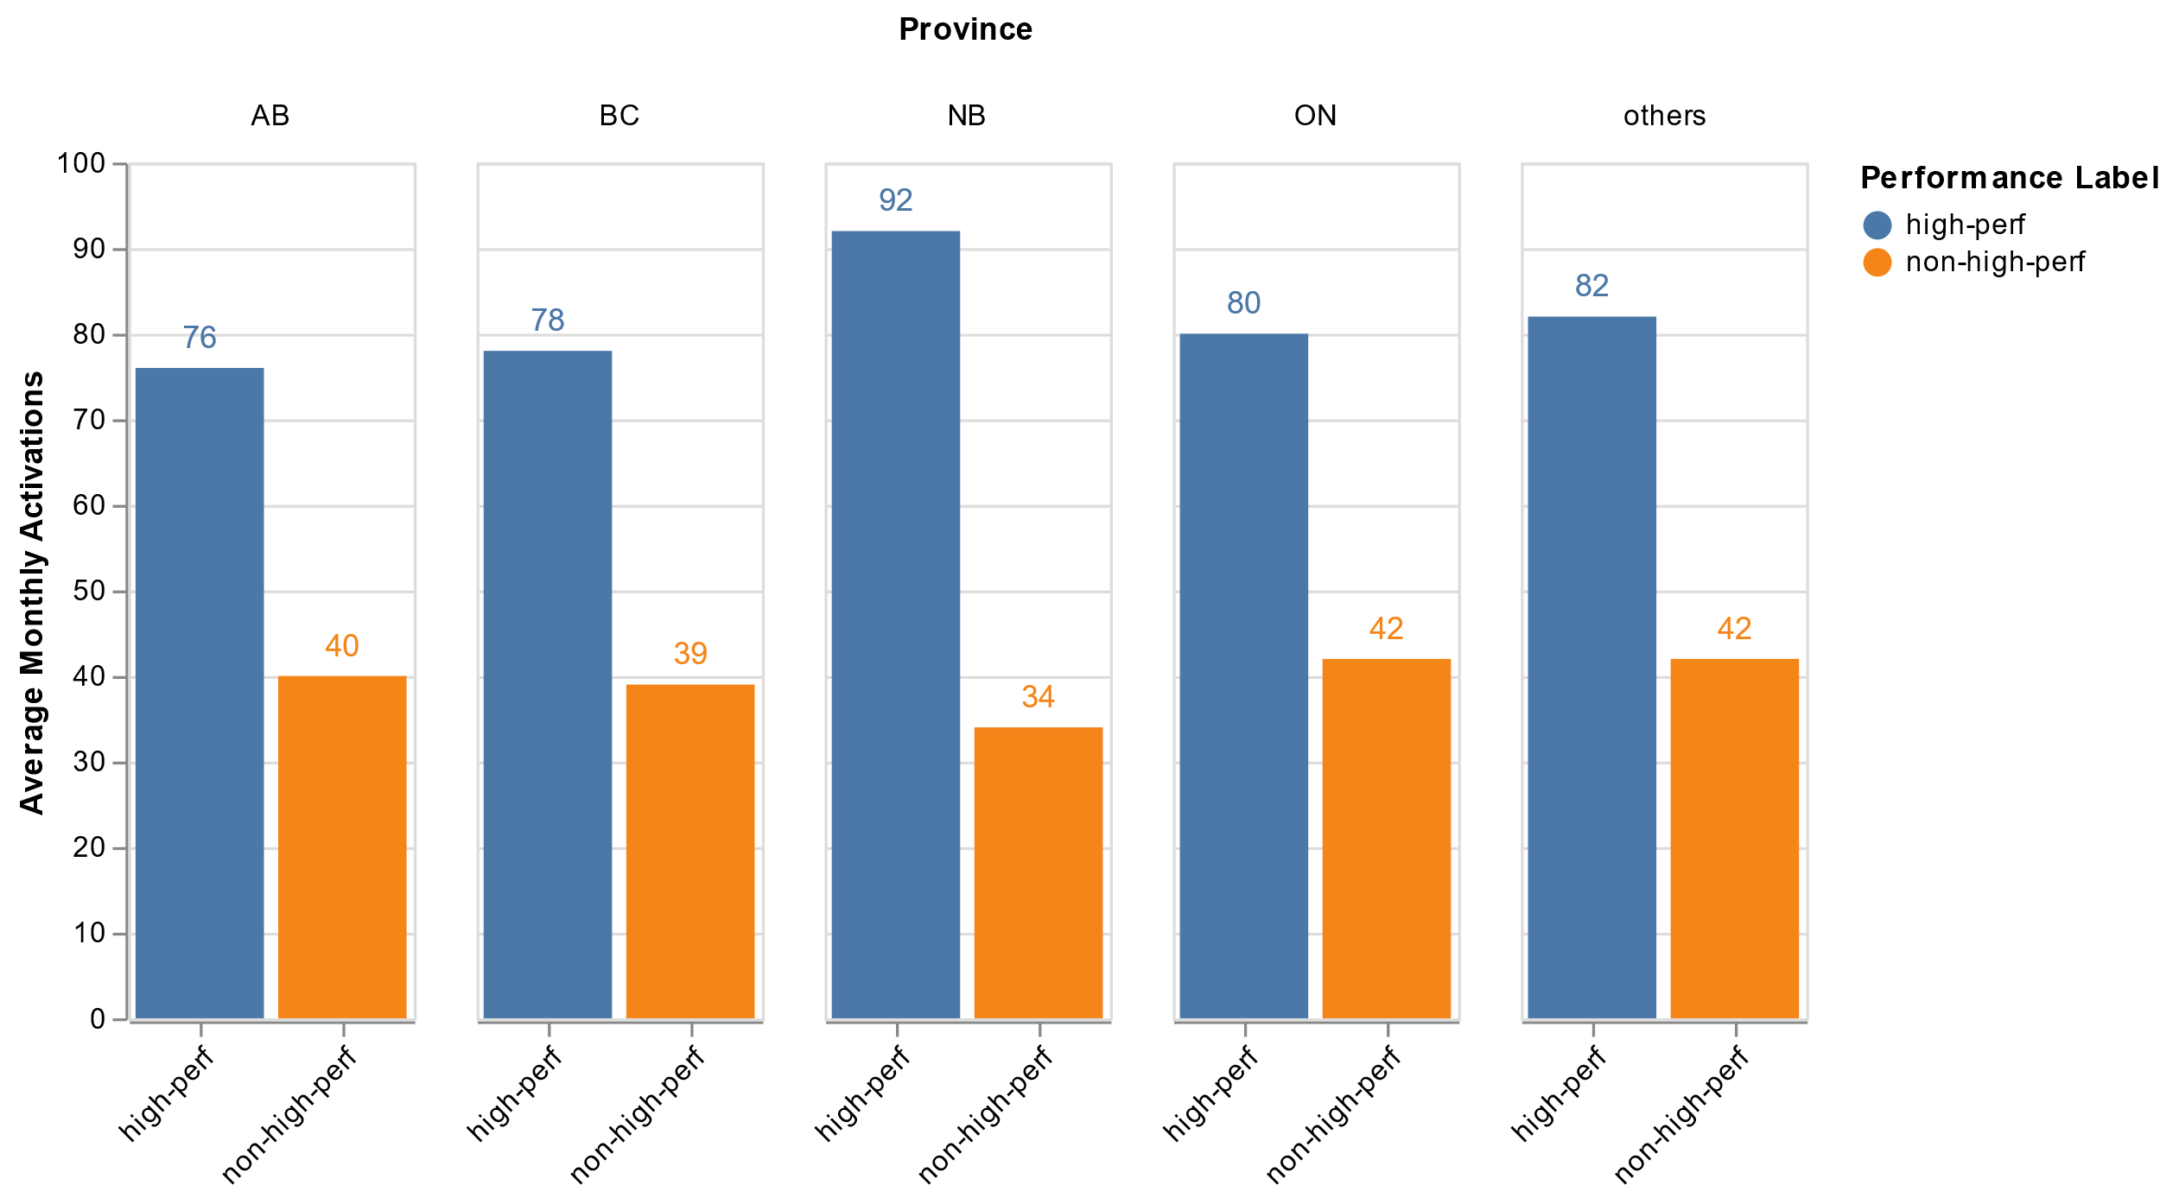
What is the difference between High performers and Non High Performers?
These behavior is observed across all provinces

Slide 14
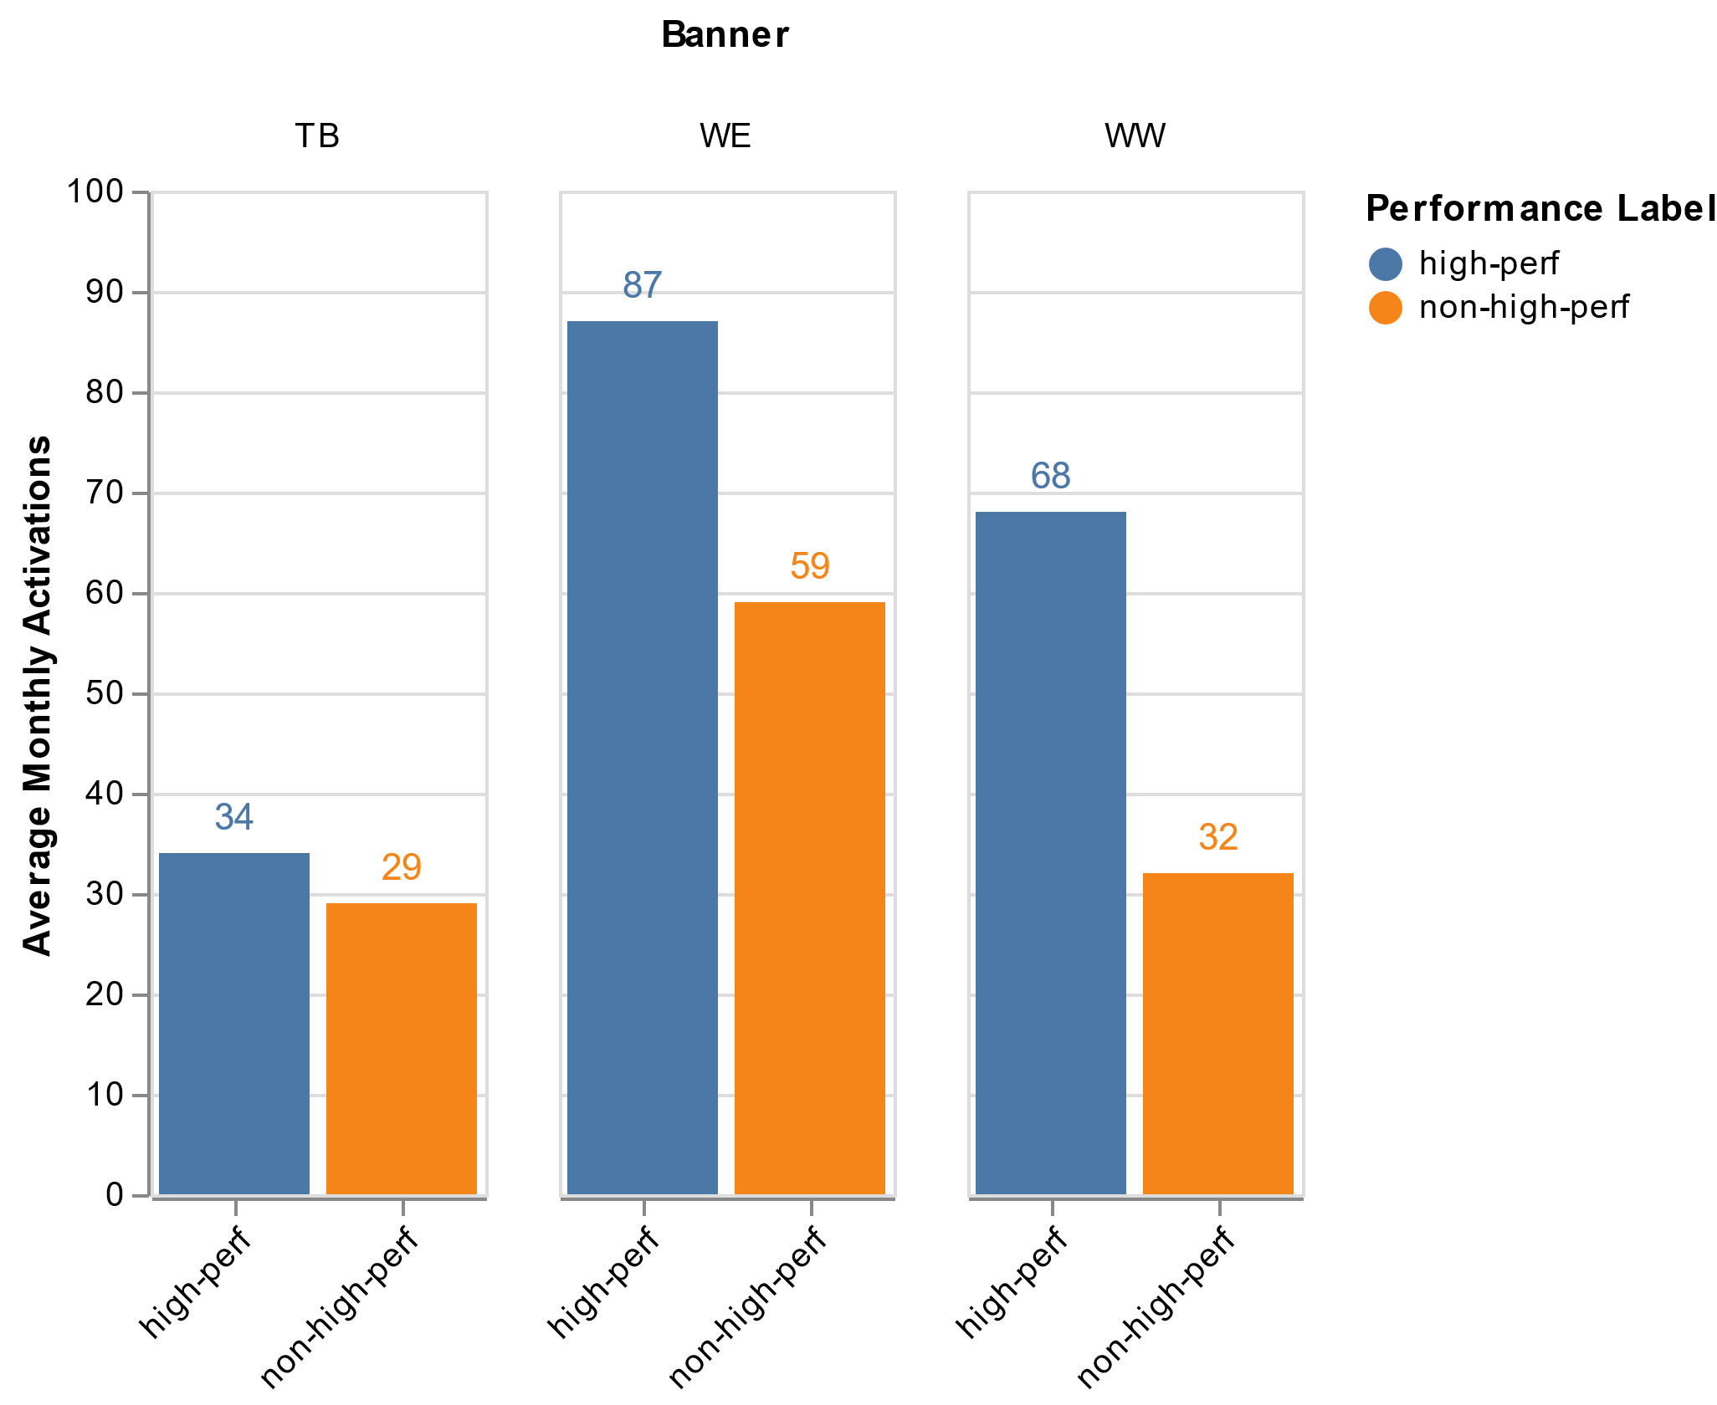
What is the difference between High performers and Non High Performers?
High and low performers are not that different in the TB banner

Slide 15
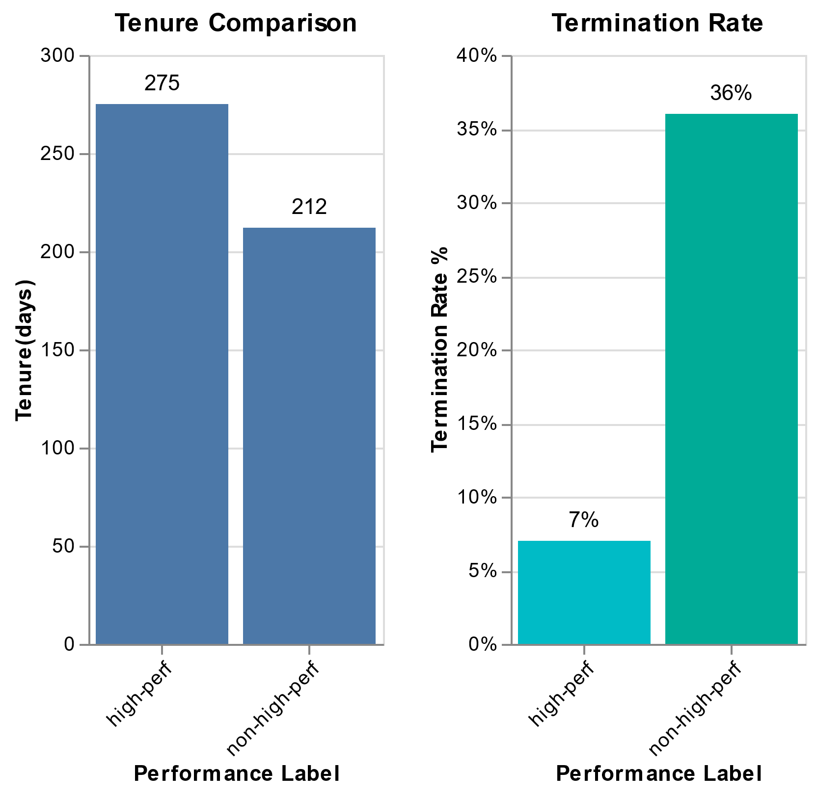
What is the difference between High performers and Non High Performers?
Overall the average tenure of the analyzed sample is 228 days (7.6 months)
In this analyzed tenure:
36% of non-high performances end up terminating their contracts.
7% of high performers end up terminating their contracts.
*Important to remember :employees who were terminated in the first 3 months, are not part of this analysis.

Slide 16
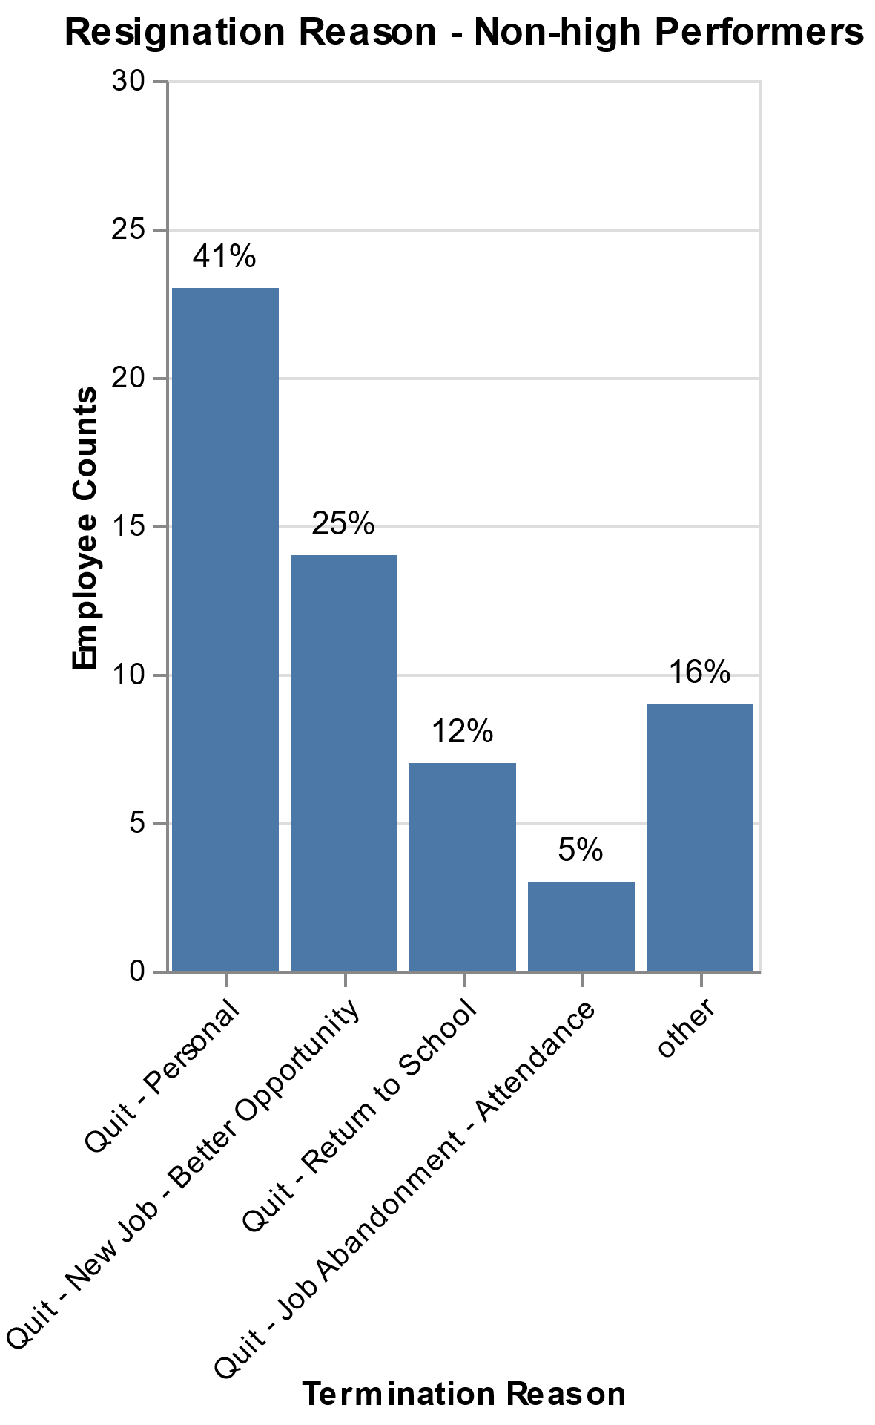
What is the difference between High performers and Non High Performers?
Considering the non-high performers who resigned:
41% quit for personal reasons.
25% because they found a better opportunity.
12% return to school.

Slide 17
Objective
Identify the traits of high performers

Slide 18



Data Extraction
Resume
Human Extracted Information
SQL Tables

Slide 19
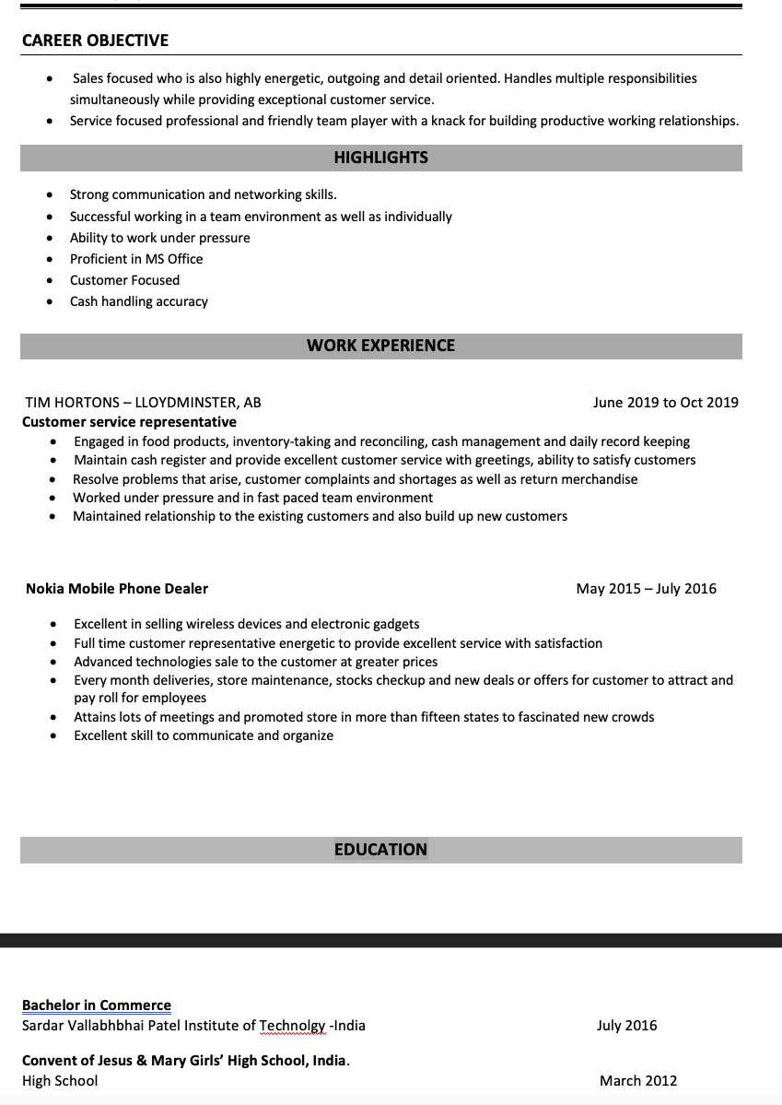
Data Extraction – Resumes Career Builder
Resume Example
Resume Text Extraction Example
hardworking dedicated conscientious individual look contribute talent energy continue grow positive high energy work environment Brodie experience Wireless Account Executive February present maintain long term business relationship client build strong personal rapport gain deep understanding client need develop telecommunications solution base information gather Networked individual business provide ongoing customer care support Wireless Algonquin Manager January February Identified secure strong candidate available branch position train coached team member accord personal strength order achieve quarterly annual target increase branch sale year year year branch manager Wireless Business Specialist April January identified potential business opportunity cold call networking build strong rapport potential client order present solution relevant specific need goal priority SKILLS excellent communicator write verbal excellent customer relation retainment skill effective leadership team role able understand retain knowledge product policy procedure award appoint chair Youth Advisory Council Town Achieved National Star Certification rank Chief Warrant Officer Royal Canadian Army cadet Optimist Club Citizenship Award Awarded excellence customer service Liaison College Culinary Arts March September graduate Honors Collegiate Institute September June

Slide 20
Data Extraction – Resume Information
Employee Code | Work#_title | Work#_ company | Work#_ time | Education#_ school | Education#_ degree | Education#_ concentration | Education#_ country
N** | Sales Associate | Virgin Mobile | Jan 2017 – Present | York University | Bachelor | Business | Canada
M** | Cashier | McDonalds | Jun 2019 – Current | Fraser Valley University | Bachelor | Arts | Canada
N** | Store Manager | Walmart | March 2008 to May 2013 | St Joan Arc Catholic | High School | General | Canada
Human scraping information from resumes
Work resume information 1-7
Education resume information 1-4

Slide 21
Data Extraction – Tabular SQL
Active + Leave (weekly)
Terminations
Employee Plateau Levels by Month
New Hires
Referrals

Slide 22
Features
Feature Category | Number of Features
Work Experience – Position Level | 15
Academic Background | 13
Knowledge and Skills | 10
Work Experience – Industry Level | 7
Readability – Spelling & Grammar | 3
Job Tenure – General | 5
Education level | 4
Job Count | 4
Job Count – Tenure - Industry Level | 3
Internal Glentel Profile | 2
Work Experience – Industry Level Recently | 2
11 Feature Groups
68 Features
61 Numeric features
7 Categorical

Slide 23

Features – Work Experience Position
Examples
Administrative
Telemarketer
Management
Fitness and Sports
Cashier

Slide 24

Features – Academic Background
Examples
Business
Arts
Interactive Arts and Technology
Background Highest Degree
Finance

Slide 25

Features – Knowledge and Skills
Examples
Problem Solving
Volunteer Experience
Trilingual Flag
Communication Skills
Sales Customer Base Exp

Slide 26

Features – Work Experience Industry
Examples
Clothing and Footwear
Food Service
Sports, Travel, Entertainment and Hotel
Competitor Experience
Not enough sample size to determine which competitor is best

Slide 27

Features – Job Tenure General
Examples
Job Hopper
Total months of Work Experience
Shortest Tenure

Slide 28

Features – Education Level
Examples
Highest Degree
Country Highest Degree
flag_hd_highschool

Slide 29
Machine Learning Model
Predicted Performance
Non-High Performer
High Performer
True Negative
False Negative
Non-High Performer
F1 Score
Takes into consideration
False Positive
False Negative
Recommend for unbalance sets
Actual Performance
False Positive
True Positive
High Performer

Slide 30
Machine Learning Model – Feature Selection
Highest Degree
Arts
Trilingual Flag
LassoCV
9/68 features selected
All features make sense
Food Service
REFCV
46/68 features selected
Does not handle multicollinearity
Trilingual Flag

Slide 31
Machine Learning Model – Model Selection

Slide 32
Machine Learning Model – Testing Perform
Predicted Performance
Non-High Performer
High Performer
27
23
Non-High Performer
Our finalist model was able to
predict ~70% high performers
even though only 30% of employees in
the testing dataset are high performers
Actual Performance
7
15
High Performer

Slide 33
Machine Learning Model – Comparing Features
Remove features one at a time and see if the machine learning model strengthens or weakens
source

Slide 34
Machine Learning Model – Comparing Features
Feature | Training F1 | Testing F1
All Features | 0.509 | 0.500
Academic Background | 0.485 | 0.526
Education Level | 0.497 | 0.448
Job Tenure General | 0.527 | 0.448
Knowledge and Skills | 0.509 | 0.500
Work Experience Industry | 0.478 | 0.333
Include all informative features generated by feature engineering
Exclude one group of features each time

Slide 35
Final Model Traits Selection
Final Features Model Selected
Feature Final Model | Coefficients
Finance Concentration | 0.19
Flag HD Highschool | -0.23
Shortest Tenure | 0.16
Trilingual Flag | 0.25
Sales Customer Base Experience | 0.30
Communication Skills | 0.13
Competitor Experience | 0.32
Cashier Job Title | 0.16
Fitness Sport Job Title | -0.20

Slide 36
Machine Learning Model – Comparing Features
Dashboard Demo

Slide 37
Conclusions
The project was successful in identifying traits correlated to high performers.
9 relevant traits were identified by the model.
Understanding high performers traits may result in an increase in monthly activations and decrease in personnel rotation.

Slide 38
Recommendations
Implement an additional information extraction form in hiring process.
Model not be used as hiring tool. A human must always be in the loop.
Complement study with French resume information.

Slide 39
Recommendations
Complementing the study with the development of an automatic resume data extraction tool.

